Slide 1

Topic name : portfolio course code : cse-0402 course name : e-commerce & web engineering submitted by farhana rahman id : Ug02-47-18-031 Department of cse --- submitted to khan md. Hasib lecturer , department of csE

Slide 2
outlineS
* INTRODUCTION
* DEVELOPMENT – TOOLS
* DEMO PICTURES OF PROJECT
* ADVANTAGES
* DISADVANTAGES
* FEATURES
* CONCLUSION

Slide 3
iNTRODUCTION
* A PERSONAL PORTFOLIO IS AN EVIDENTIARY DOCUMENT DESIGNED TO PROVIDE QUALITATIVE AND QUANTITATIVE INFORMATION.
* THREE TYPES OF PORTFOLIO :
1) A SHOWCASE PORTFOLIO
2) AN ASSESSMENT PORTFOLIO
3) A DEVELOPMENT PORTFOLIO

Slide 4
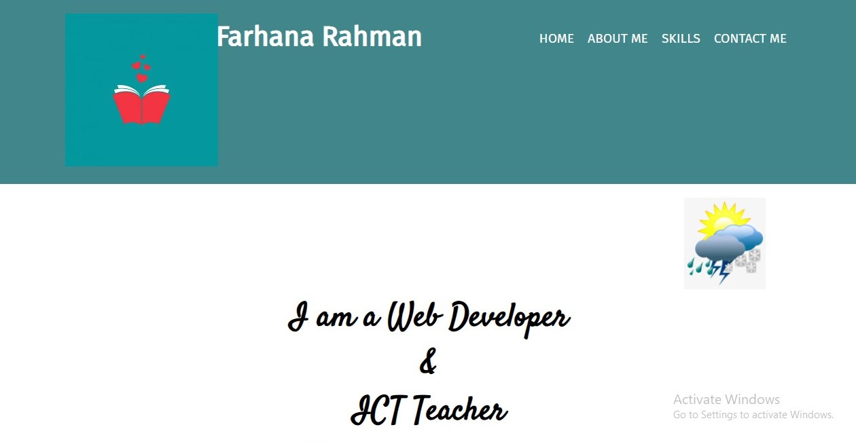
1ST PAGE

Slide 5
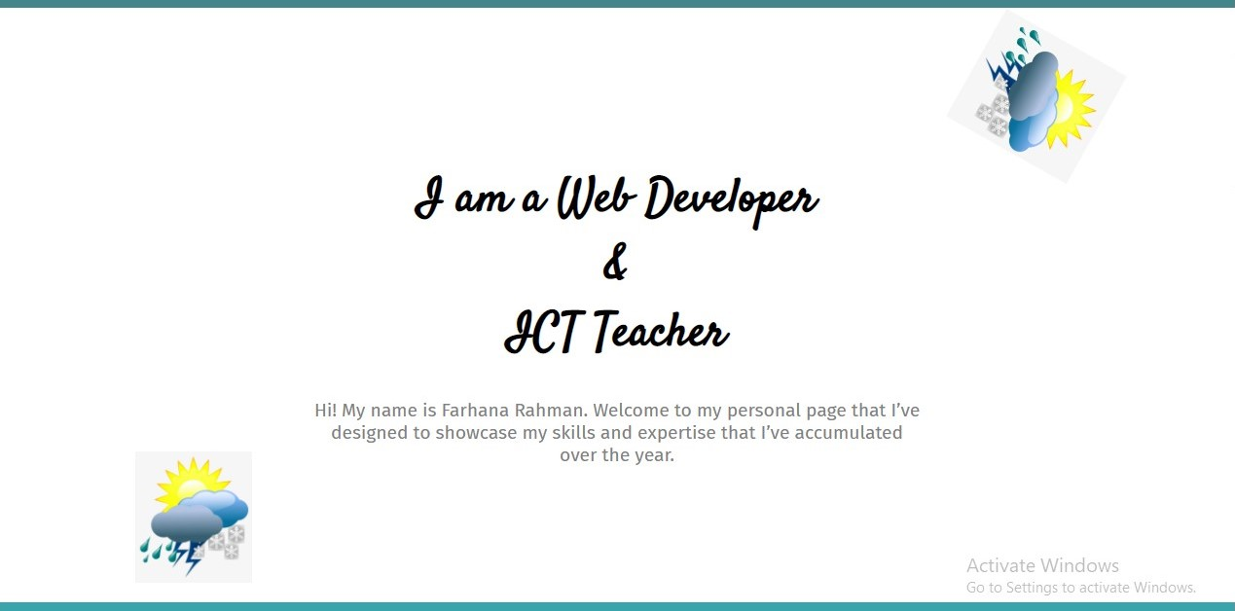
2ND PAGE

Slide 6
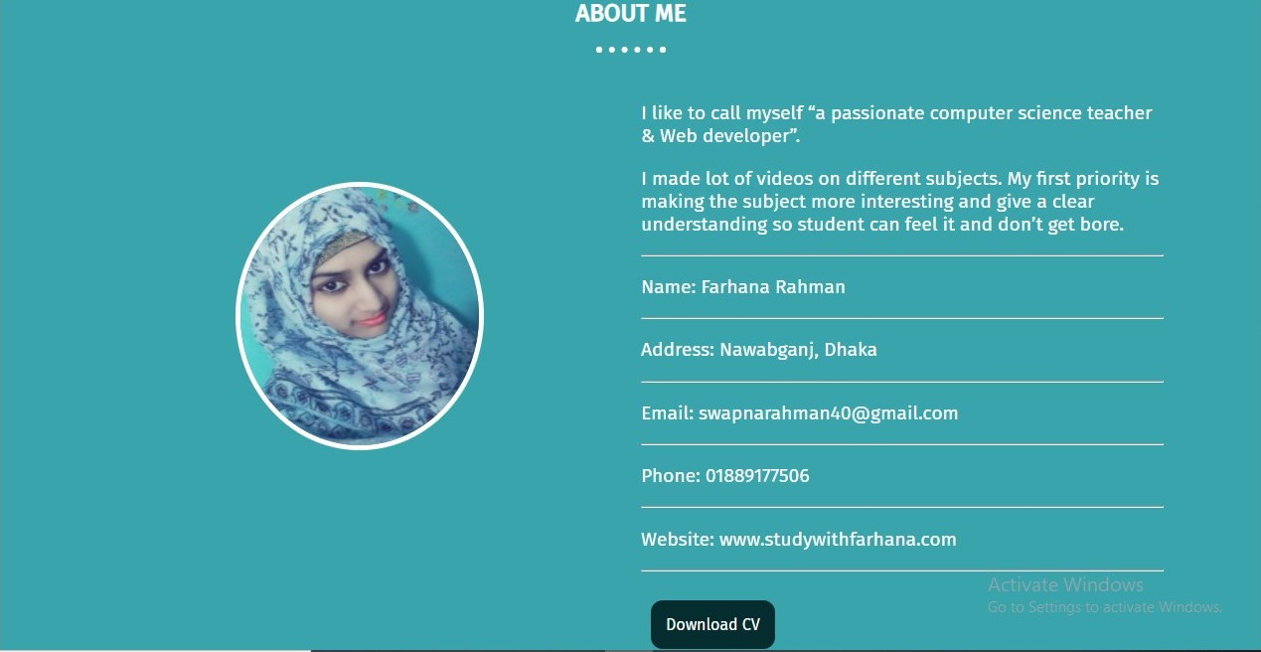
3RD PAGE

Slide 7
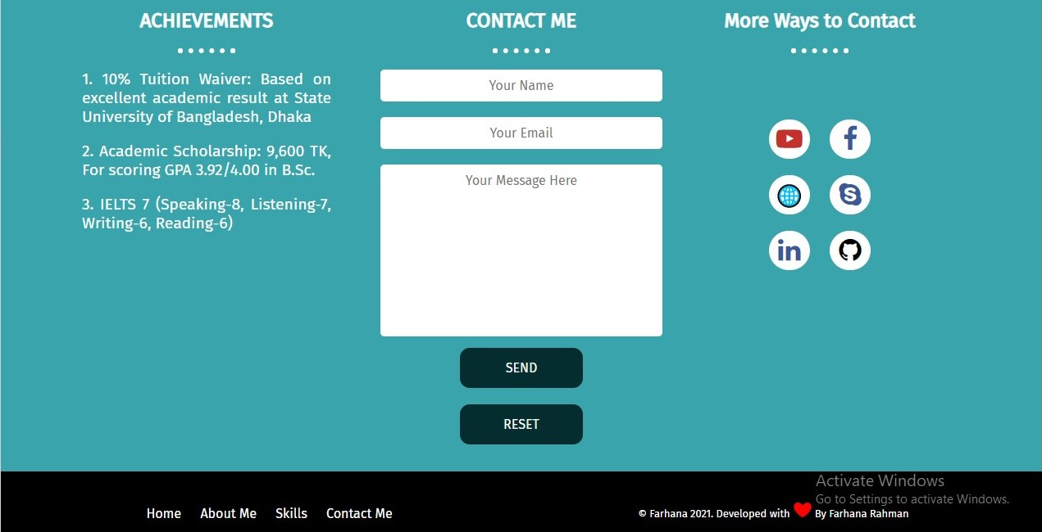
4TH PAGE

Slide 8
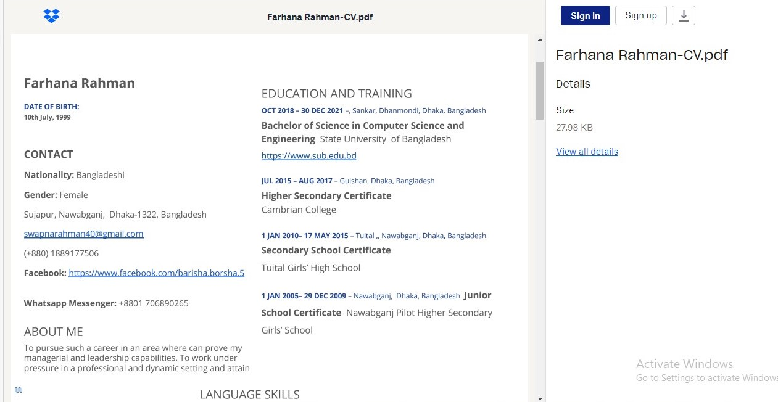
CV ATTACHMENT

Slide 9
Development tools
* LANGUAGE : HTML, CSS, JAVASCRIPT
* WEB BROWSER : INTERNET EXPLORER
* SOFTWARE : NOTEPAD , VS-CODE

Slide 10
ADVANTAGES
* PROVIDES A PLATFORM TO SHOWCASE OUR WORK
* AMPLIFIES OUR ONLINE PRESENCE
* GOOD FOR FUTURE CLIENTS & POTENTIAL EMPLOYERS
*ESTABLISHES OUR PERSONAL BRAND
* REFLECTS OUR PERSONALITY & CREATIVITY
* DISPLAYS CONSISTENCY & PROFESSIONALISM

Slide 11
DISADVANTAGES
* TOO COMPLICATED
* INDEXING
* MARKET RISK
* BELOW AVERAGE RETURNS
* LACK OF FOCUS OR ATTENTION TO OUR PORTFOLIO

Slide 12
FEATURES
* HOME
* ABOUT ME
* DOWNLOAD CV BUTTON (ATTACHED WITH DROPBOX)
* WORK EXPERIENCE
* EDUCATION & TRAINING
* SKILL
* CONTACT ME -
- YOUR NAME
- YOUR E-MAIL
- YOUR MESSAGE
> SEND BUTTON
> RESET BUTTON
*ACHIEVEMENTS
* MORE WAYS TO CONTACT

Slide 13
CONCLUSION
The use of the ePortfolio for the purpose of development and management of knowledge and skills is booming. Today, we made the shift to a knowledge society and digital culture. The emergence of ePortfolios is entirely consistent with this shift. We use technologies at our disposal to better serve citizens and to provide better service to learners; therefore, we have to use the ePortfolios.

Slide 14


Slide 15


